Slide 1
Signal in linux

Slide 2
content
Fundamental concept
Signal categories
Signal type and action
Signal handler
Signal set and mask
Abort and alarm
Coredump file
Realtime signal

Slide 3
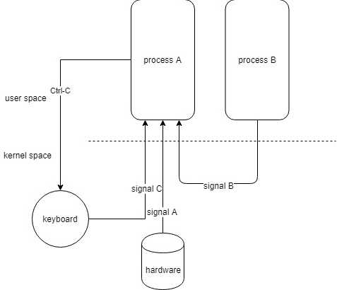
Fundamental concept
Overview
A notification to process that an event has occurred
software interrupt
In most case, it is not possible to predict exactly when a signal arrive
A process can send a signal to other process or itself – a form of IPC
Normal source of various signal is the kernel. And type of events that cause the kernel to generate a signal for a process
Hardware exception occur – Malformed machine language instruction, dividing 0, access to part of memory that inaccessible
The user typed one of the terminal special character as interrupt character (Ctrl-C) or suspend character (Ctrl-D)
Software event – Input become available of file descriptor, terminal window is resize, timer went off, CPU time limit was exceeded or child of process is terminated

Slide 4
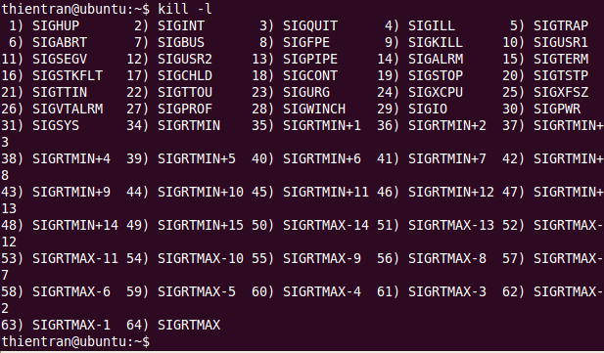
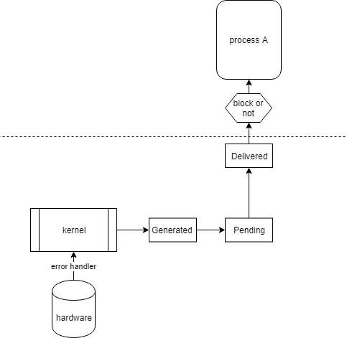
SIGNAL CATAGORIES
Each signal is defined with unique number (start from 1)
kill –l
Two categories of signal : standard (1 to 31) and real-time signal
A signal is generated for a event, then it delivered to a process, time between generated and delivered is pending
A pending signal is delivered to a process as soon as it is next scheduled to run or immediately if process is running already (send signal to itself)
Sometime in order to ensure that a segment of code is not interrupted by the delivery of signal. Program add a signal to process signal mask and set of signal will block until it remove from signal mask

Slide 5
SIGNAL ACTION
Upon delivery of signal, a process carries out one of the following default action
ignored – it is discarded by kernel and has no effect on process
abnormal process termination
Cored dump file and process termination
Execution process is stopped
Execution process is resumed after stopped
A program can set the signal disposition
Default action
Ignored
Signal handler

Slide 6
Signal types and default action
Signal name | Description | Default action
SIGARBT | A process receive this signal when it calls abort function | terminate process; generate core-dump (use for debugging)
SIGALRM | Kernel generate this signal upon the expiration of a realtime timer that setup by alarm or setitimer function | terminate process
SIGBUS | Generation to indicate certain kind of memory error. One of such error is access to an address beyond underlying memory-mapped file | terminate process; generate core dump
SIGCHILD | Kernel generate and sent to parent process when one of child process terminate, kill by signal, stopped | Irgnored
SIGCONT | Kernel generate and sent to parent process when one of child process resume from stopped state | Resume process
SIGFPE | Generation to indicate certain type of arithmetic, such as devide-by-zero | terminate process; generate core dump

Slide 7
Signal types and default action (2)
Signal name | Description | Default action
SIGHUP | When terminal disconnect this signal will send to controlling process of terminal Deamon use this signal to reinitialize itself and update the configuration | terminate process
SIGILL | Process tries illegal machine-languge instruction | terminate process; generate core dump
SIGINT | User type interrupt character Ctrl-C | terminate process;
SIGIO | Generate a IO event occur on certain type of file descriptor such terminal of socket | terminate process;
SIGKILL | Sure kill signal. Terminate process. Cannot blocked, irgnored, caught by a handler | terminate process
SIGPIPE | Process tries to write to PIPE , FIFO, or socket that closed | irgnored
SIGTRAP | Use for debugging tool as gdb for breakpoint trace | terminate process; generate core dump

Slide 8
Signal types and default action (2)
Signal name | Description | Default action
SIGQUIT | User type quit character Ctrl \. This signal useful with program stuck in an infinite loop or otherwise not responding | terminate process; generate core dump
SIGSEGV | Very popular, is generated when program make an invalid memory reference as page is not exist, write to read only area, access the kernel memory, dereferencing a pointer containing a bad address … | terminate process; generate core dump
SIGSTOP | To surely give a process to stopped state. It cannot blocked, ignored, caught by handler | stop process;
SIGTERM | To terminate a process gracefully. Free all resource explicitly. | terminate process;
SIGKILL | Sure kill signal. Terminate process. Cannot blocked, irgnored, caught by a handler | terminate process; not generate core dump
SIGUSR1/SIGUSR2 | Programmer define purpose | terminate process;

Slide 9
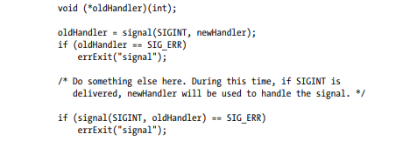
Changing signal disposition -signal
signal function
Have arguments as signal number and signal handler
Return previous disposition
SIG_DFL
Reset the disposition to its default
SIG_IGN
Ignore the signal

Slide 10
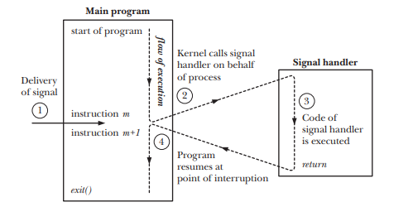
SIGNAL handler
Signal handler
can interrupt flow of main program
After signal handler return, execution of the program resumes at the point where the hander interrupt it
Signal handler can do anything, but it should be design as simple as possible
A program can setup the same handler for multiple signal

Slide 11


Sending SIGNAL
kill
A process send signal to other process
Broadcast signal when pid is -1
Checking for existence of process with sig = 0, no signal send to process
ESRCH – receiving process doesn’t exist
EPERM – sending process doesn’t permission
Success – sending process have permission and receiving process exist
raise
sending signal to itself
equivalent with kill(getpid(), sig)

Slide 12



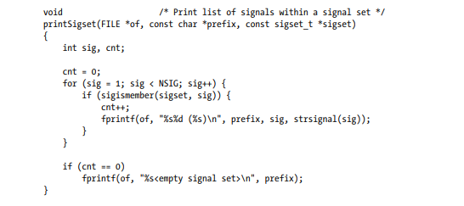
SIGNAL SETS
signal sets framework
Allow a group of signal stand together into a group
A bitmask method

Slide 13
Signal mask
Process signal mask
A set of signal whose delivery to process is currently block
Sigprocmask use to explicitly add signal to or remove signal from the signal mask
Signal are not queued
how
SIG_BLOCK
SIG_UNBLOCK
SIG_SETMASK

Slide 14
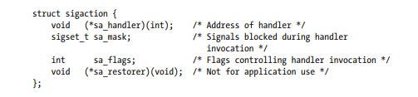
Changing signal disposition - sigaction
sa_flags
Bitmask specifying how signal handler, use OR for multiple options
SA_NOCLDSTOP – If signal is SIGCHLD, don’t generate this signal when a child process stopped/resume
SA_NOCLDWAIT – if signal is SIGCHLD, don’t transform children into zoobies when they terminate
SA_NODEFER – when signal is caught, don’t add it to the process signal mask while the handler executing
SA_ONSTACK - Invoke the handler for this signal using an alternate stack installed by sigaltstack() func
SA_RESETHAND – When this signal caught, reset its disposition to the default before invoking the handler
SA_RESTART – Automatically restart system calls interrupted by this signal
SA_SIGINFO – Invoke the signal with addition argument
sigaction
More complex but more flexibility
Get current disposition without changing it
Setup various control what happen when signal handler is invoked

Slide 15

Waiting for a signal
pause
Suspend execution of process until the call is interrupted by a signal handler
Pause always return -1 when signal arrive

Slide 16
TERMINATE a process with abort
abort function
Terminate calling process by raising a SIGABRT signal
Default action is generated a core dump file and terminate process
The core file use to debug the program at the time of the abort()

Slide 17
RAISE a timer with alarm

Slide 18
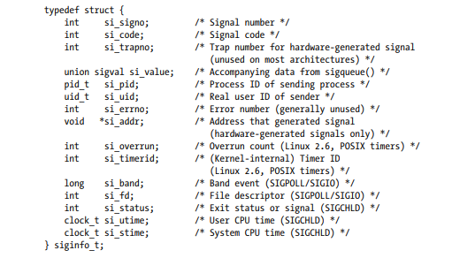
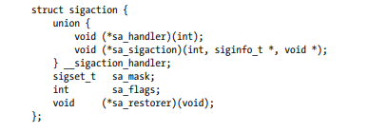
SA_SIGINFO Flag
SA_SIGINFO
Allow the handler obtain additional information about signal when it is delivered
The handler need to declare full arguments
siginfo_t will provice full information of signal

Slide 19
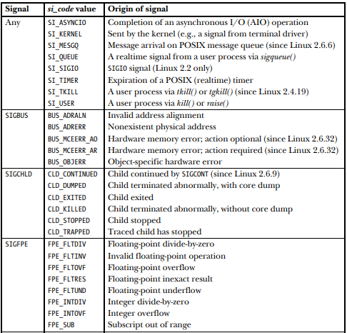
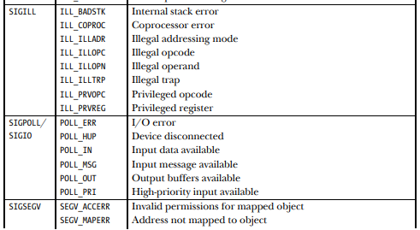

Si_code of SIGINFO_t

Slide 20

INTERRUPT AND RESTART SYSTEM CALL
SA_RESTART
Scenario
We establish a handler for some signal
We call blocking system call like read on terminal
When the system call is blocked, signal delivered and signal handler is invoked
System call break and return error with EINTR and we prefer to continue the execution of interrupted system call
Don’t need to check errno EINTR case
System call restart automatically

Slide 21
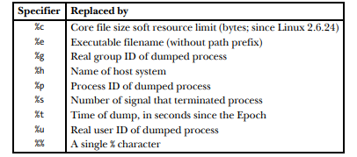
The core dump file
Debug issue
Certain signal cause a process core dump and terminate
A core dump is file containing a memory image of process at the time it terminated
This file loaded into the debugger in order to examine the state of a program code and data at the time signal arrive
Ctrl \ cause SIGQUIT signal
Core is generated at working directory
/proc/sys/kernel/core_pattern
Some situation core dump is not generated
The process don’t have permission to write
A regular file has same name exist
The working directory is not exist
Process resource limit on the core dump size is 0
Process resource limit of the file process created is 0
Disk is out of space

Slide 22
Some special case
SIGKILL and SIGSTOP
Cannot change default action for SIGKILL and SIGSTOP, SIGKILL always terminate process, SIGSTOP always stop the process
SIGCONT
Always continue a stopped process event it blocked or ignored
Hardware-generated signals (SIGBUS, SIGFPE, SIGILL, SIGSEGV )
The behavior of process is undefined if it returned from a handler for signal or if it ignored or blocked
It can be cause a loop of signal to process when return from signal handler
Linux force a delivery and terminate process event if process tries to block or ignore these signals
It is highly recommend process terminate and produce a core file to find the reasons that cause these signals

Slide 23
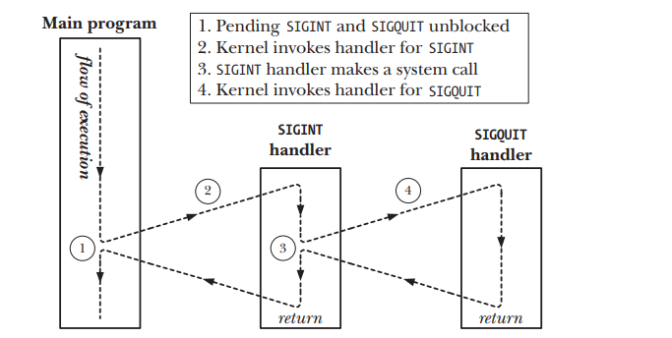
Timing and order of signal delivery
Signal delivered
Hardware exception triggers a signal or a process raise signal to itself, signal delivered immediately
When signal send from process to process, it delay a little time because kernel only delivered signal to process when it is scheduled

Slide 24

Realtime signal
Realtime signal
Defined by POSIX, use for application defined purposes
Realtime signal is queue. If multiple realtime signal is sent to process, it is delivered multiple-time. In contrast, we send multiple-signal that pending already for process, it sent only once
When sending a realtime signal, it is possible to specific data that accompanies with signal
The order of delivery of realtime signal is guarrentee
Limits on the number of queued realtime signals
Queueing realtime signal with associated data requires that the kernel maintain data structures listing the signal queued for each process
This will consume kernel memory and kernel places limit on the number of realtime signal that queued
Default is 32

Slide 25
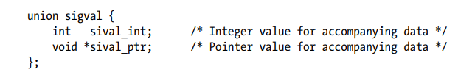
SENDING and HANDLING REALTIME SIGNAL
Sending realtime signal with sigqueue
Same meaning with kill even when sig = 0
Value bring data accompany the signal
sigqueue error when number of signal in queue reach max
Handling realtime signal
Sigaction with SA_SIGINFO

Slide 26
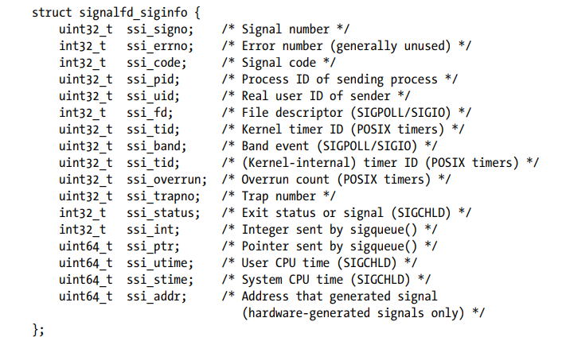
Fetching Signals via a File Descriptor
Signal handler as driven I/O
Signal represent by file descriptor
Can use with select
Read more information with signalfd_siginfo

Slide 27
Function review
signal
Kill
Raise
Abort
Pause
sigqueue
Sigprocmask
Signalfd

